Slide 1
Predicting NYC Taxi demands
during peak hours
Group Members:
Divya Lingwal
Shivani Mathur
Monalisa Singh

Slide 2
Problem Description
DATA:
Green Taxi data for year 2017 ( Jan, Feb, May and June) NYC Taxi and Limousine Commission,
Weather data for the months mentioned to see the effect it creates on the demands.
Prediction:
Taxi Demand on the basis of Passenger demand
Passenger Demand at a Particular location on a particular time
Application:
Taxi companies can dispatch required number of taxis to different locations on the basis of predicted demand which will reduce cost for the taxi companies. It also helps in managing traffic as most of the people in NYC depend on Hailing instead of Pre-Booking.
Tools used: R and Weka

Slide 3
Attributes
TAXI DATA
VendorID
Lpep_pickup_datetime : PickupDate, PickupTime, and HourOfTheDay
Lpep_dropoff_datetime
Passenger_count
Trip_distance
POLocationID
DOLocationID
RateCodeID
Store_and_fwd_flag
Payment_type
Fare_amount,Extra, MTA_tax
Trip_type
Tip_amount
Total_amount
WEATHER DATA
Date
Maximum temperature
Minimum Temperature
Average Temperature
Precipitation
Snowfall
Snow Depth

Slide 4
Loading Data in R (Green Taxi Data)
#Loading Jan,Feb,May,June Data Into R
library(dplyr), library(ISLR)
Jan_Data <- read.csv("D:/UniversityData/Allstdydata/Datamining/Project/data/green_tripdata_2017Jan.csv")
Feb_Data <- read.csv("D:/UniversityData/Allstdydata/Datamining/Project/data/green_tripdata_2017Feb.csv")
May_Data <- read.csv("D:/UniversityData/Allstdydata/Datamining/Project/data/green_tripdata_2017May.csv")
June_Data <- read.csv("D:/UniversityData/Allstdydata/Datamining/Project/data/green_tripdata_2017June.csv")
# Combining all the Data
Combined_Data <- rbind(Jan_Data,Feb_Data,May_Data,June_Data)

Slide 5
Loading Weather Data
#Loading the weather data in r
Weather_data=read.csv("C:/Users/shiva/Documents/DataMining/Project Materials/Data/weather_data_nyc.csv")
#Creating a column called Month_of_year
Temp=strptime(Weather_data$date,format='%m/%d/%Y',tz='America/New_York')
Weather_data$Month_of_year = as.numeric(format(Temp, "%m"))
# Filtering the Jan,Feb,May,June data
Weather_data_Filtered=filter(Weather_data,(Month_of_year==1) |(Month_of_year==2) | (Month_of_year==5)| (Month_of_year==6))

Slide 6
Cleaning Weather Data and Imputing values
#Cleaning Weather_Data
library(scales)
Weather_data$date <- dmy(Weather_data$date)
Weather_data$date <- format(as.Date(Weather_data$date),"%m/%d/%y")
Weather_data$precipitation_NEW <- as.numeric(gsub("T",0.01,Weather_data$precipitation))
Weather_data$snow.fall_NEW <- as.numeric(gsub("T",0.01,Weather_data$snow.fall))
Weather_data$snow.depth_NEW <- as.numeric(gsub("T",0.01,Weather_data$snow.depth))
#Changing Date Column
Weather_data$lpep_pickup_date <- Weather_data$date

Slide 7
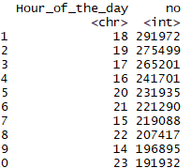
Filtering Rows for Peak hours
# Adding an hour column
Combined_Data$Hour_of_the_day = format(as.POSIXct(Combined_Data$lpep_pickup_time,format="%H:%M"),"%H")
# Finding hour of the day with highest frequency of cabs
Combined_Data %>% group_by(Hour_of_the_day) %>% summarise(no=n()) %>% arrange(desc(no))

Slide 8
Attribute Selection for Prediction of Pickups
Based on Near Zero Variance , Removed store_and_fwd_flag, RatecodeID, fare_amount,Mta_tax,tolls_amount,ehail_fee,improvement_surcharge, trip_type
nzv <- nearZeroVar(Filtered_Time_Data)
NZV_Removed_Data<-subset(Filtered_Time_Data, ,-c(store_and_fwd_flag, RatecodeID,fare_amount,mta_tax,tolls_amount,ehail_fee,improvement_surcharge, trip_type))
Calculating information gain:
library(FSelector)
information.gain(Filtered_Time_Data)

Slide 9
Filtering Rows for Peak hours & Adding day of the week
Selecting an 9:00-10:00, 15:00-16:00, 18:00-19:00
Filtered_Time_Data <- filter(Combined_Data, (Hour_of_the_day==15) | (Hour_of_the_day==18 ) |
(Hour_of_the_day=='09') )
Creating a new Column day of the week: As we expect traffic to be dependent on week days and weekends
library(lubridate),library(base)
NZV_Removed_Data$DayOfTheWeek<-as.Date( NZV_Removed_Data$lpep_pickup_date ,
'%m/%d/%y')
NZV_Removed_Data$DayOfTheWeek <- wday(NZV_Removed_Data$DayOfTheWeek,label = TRUE)

Slide 10
Zero Passenger count
Unnecessary_Attr_Removed %>% filter(passenger_count<=0) %>% summarise(n=n()
Found 83 such rows, Removed them:
Unnecessary_Attr_Removed<- subset(Unnecessary_Attr_Removed,
passenger_count>0,)

Slide 11
Analyzing Zero Distance Trips & median Imputation
#Looking for Zero Distance Trips
Trips with same source and Destination is explainable
But, There were trips with Different sources and Destinations still having Distance as 0, which can’t be explained
#impute missing values with median
Unnecessary_Attr_Removed$trip_distance[is.na(Unnecessary_Attr_Removed$trip_distance)] <- median(Unnecessary_Attr_Removed$trip_distance, na.rm = TRUE)
#impute 0 distance values with median
Unnecessary_Attr_Removed$trip_distance <- ifelse(Unnecessary_Attr_Removed$trip_distance == 0 & Unnecessary_Attr_Removed$PULocationID != Unnecessary_Attr_Removed$DOLocationID, median(Unnecessary_Attr_Removed$trip_distance), Unnecessary_Attr_Removed$trip_distance)

Slide 12
Removing Few other payment and vendor related attributes & Dividing data into Train & Test
Unnecessary_Attr_Removed <- subset(NZV_Removed_Data,,-c(VendorID,extra,tip_amount,payment_type))
After Separation: Train=413,149 rows,Validation=137,716 rows and Test =110,184 rows:
#Diving into test and train
Index <- sample(1:nrow(Complete_data),round(0.6*nrow(Complete_data)))
train_data <- Complete_data[index,]
test <- Complete_data[-index,]
index1 <- sample(1:nrow(test),round(0.5*nrow(test)))
Validation_data <- test[index1,]
Test_data <- test[-index,]

Slide 13
Merging Weather Data & Taxi Data
train_taxi$lpep_pickup_date <- mdy(train_taxi$lpep_pickup_date)
train_taxi$lpep_pickup_date <- format(date(train_taxi$lpep_pickup_date),"%m/%d/%Y")
merged_data_train <- merge(x=train_taxi,y=Weather_data,by="lpep_pickup_date")
test_taxi$lpep_pickup_date <- mdy(test_taxi$lpep_pickup_date)
test_taxi$lpep_pickup_date <- format(date(test_taxi$lpep_pickup_date),"%m/%d/%Y")
merged_data_test <- merge(x=test_taxi,y=Weather_data,by="lpep_pickup_date")

Slide 14
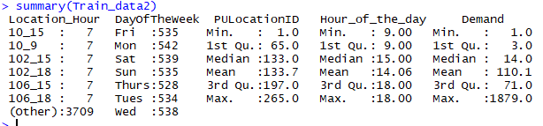
Feature Extraction
#Combining Hour of the day and Location Id
Train_data1 <- transform(Train_data,Location_Hour=paste(PULocationID,Hour_of_the_day,sep="_"))
#Generating Demand Column (The Prediction Attribute)

Slide 15
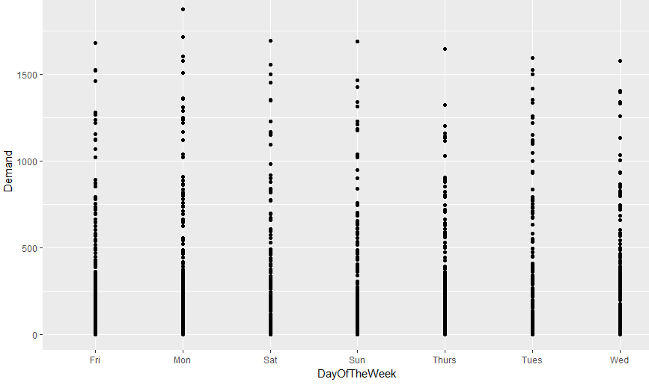
Plot of Day of week against Demand
ggplot(Train_data2, aes( DayOfTheWeek,Demand)) + geom_point()

Slide 16

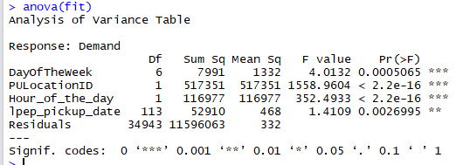
Regression Model for Training Data
fit<- lm(Demand~.,Train_data2)

Slide 17
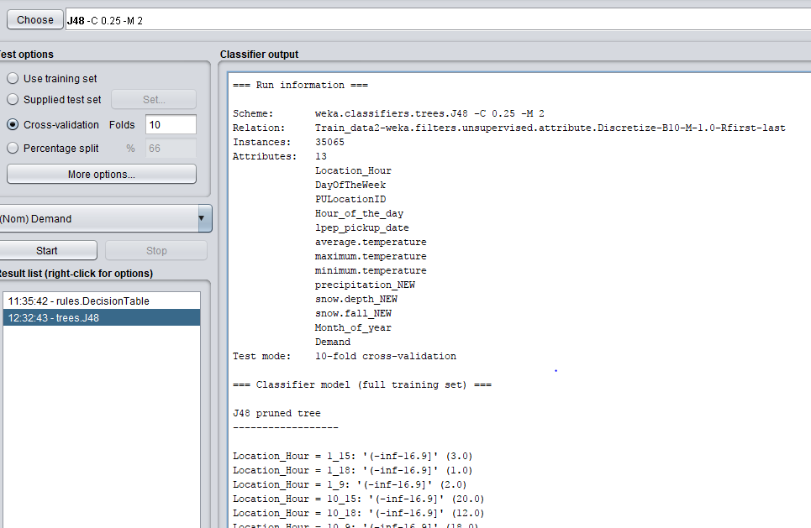
J48 On Training Data: Using Stratified Cross-Validation

Slide 18
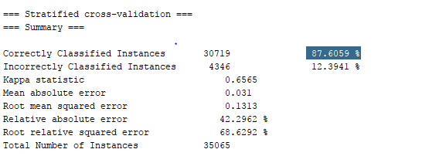
Result of J48

Slide 19
Comparison of models on Training and Validation Data
REGRESSION J48 decision tree
Coefficient of Determination (R Square): 89% | Correctly Classified Instances: 87.6%
Root Mean Squared Error: 6.07 | Root Mean Squared Error: 0.1313
Coefficient of Determination (R Square): 82.5 | Correctly Classified Instances: 66.9%
Root Mean Squared Error: 3.014 | Root Mean Squared Error: 0.0182

Slide 20
Comparison of models on Test Data
REGRESSION J48 decision tree
Coefficient of Determination (R Square): 80.2% | Correctly Classified Instances:60%
Root Mean Squared Error: 2.626 | Root Mean Squared Error: 0.1049

Slide 21
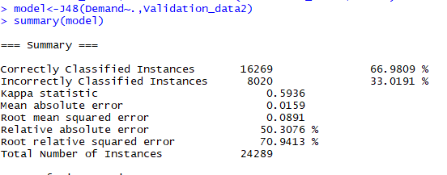
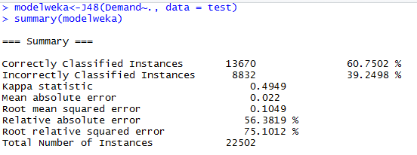
Validation and Test Data Results for J48

Slide 22
FUTURE WORK
We are planning to use Ensemble Learning methods like Random Forest to evaluate which can avoid the problem of Overfitting.
Also using Neural Network regression could fetch better results as Neural Networks perform Feature extractions automatically which is better than manually combining features.

